Slide 1
Computational Thermal Engineering
Solving Diffusion Equation in OpenFOAM
DAY 7
Kumaresh Selvakumar

Slide 2
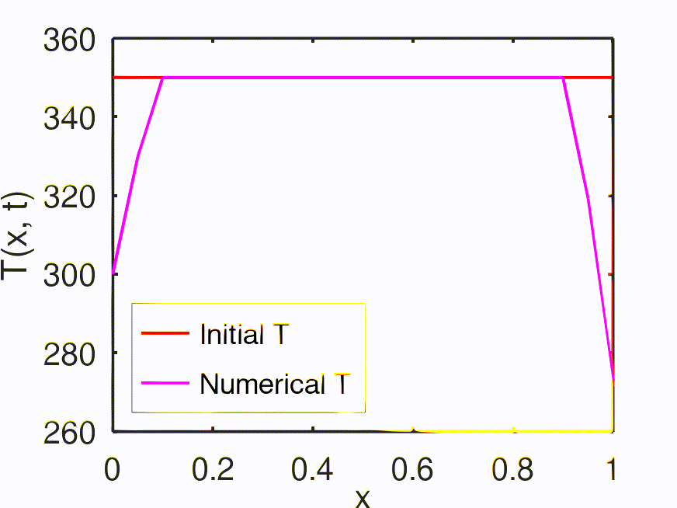
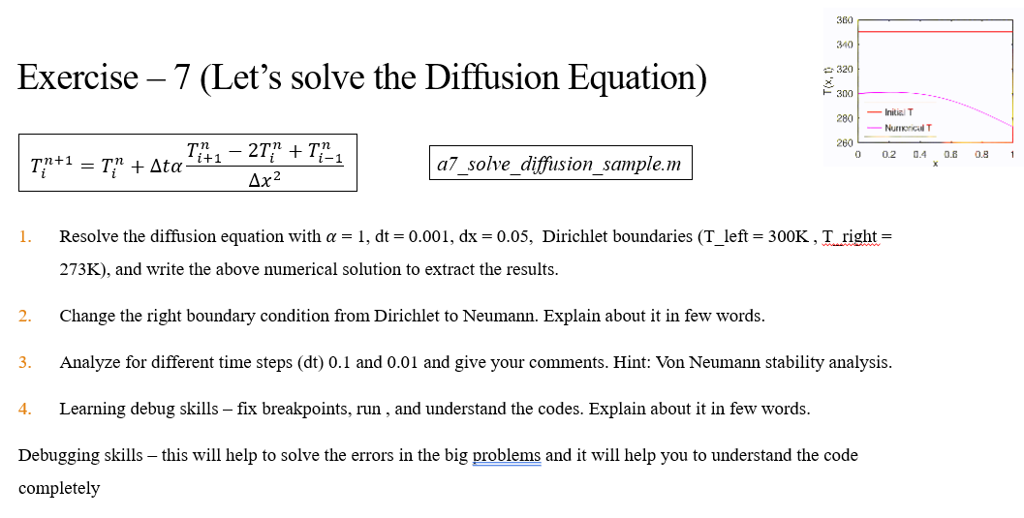
Quick Recap
Notes:
https://ezgif.com/maker
Dirichlet boundary conditions assume the solution to the variable.
In Neumann boundary conditions, a solution is assumed for the derivative of the variable.
https://en.wikipedia.org/wiki/Von_Neumann_stability_analysis

Slide 3
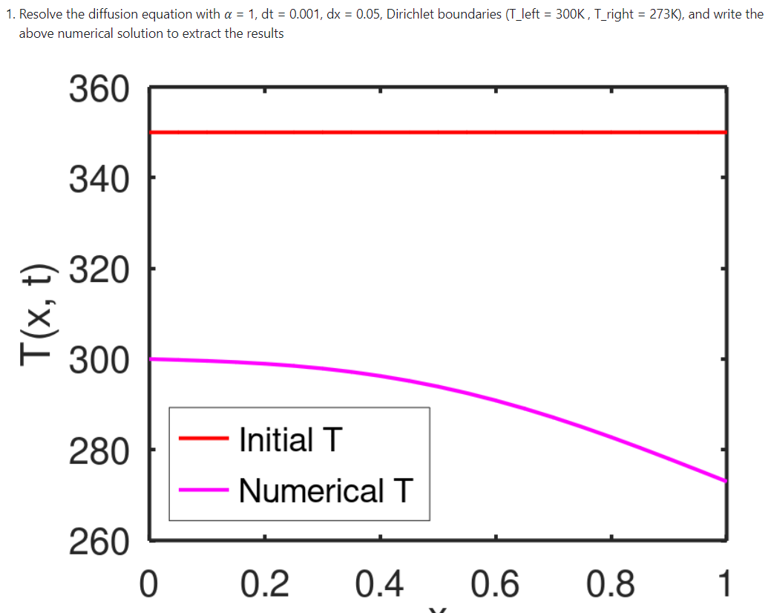
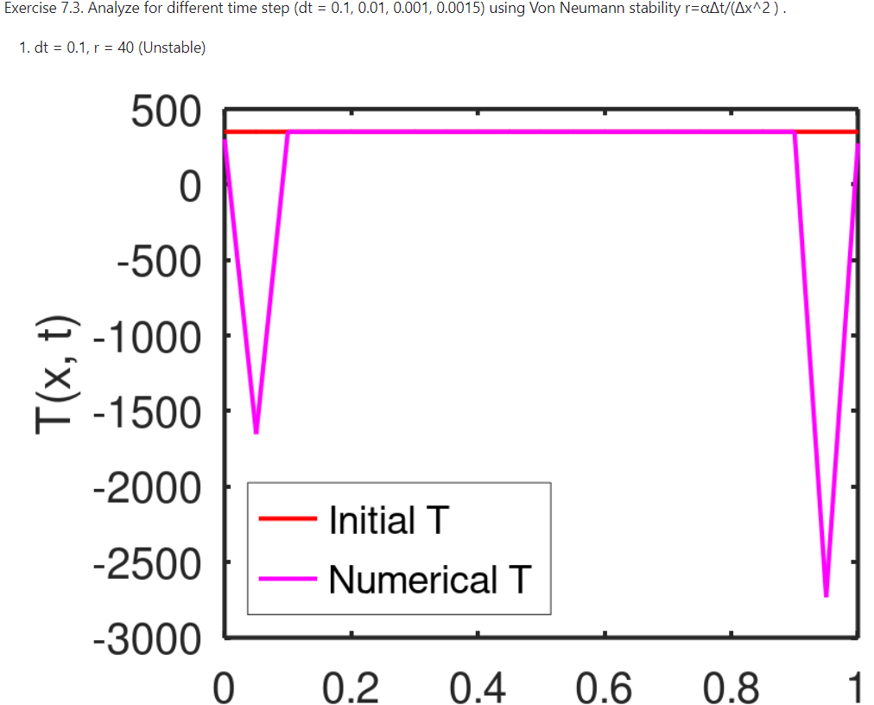
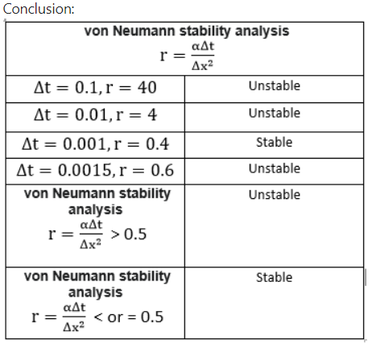
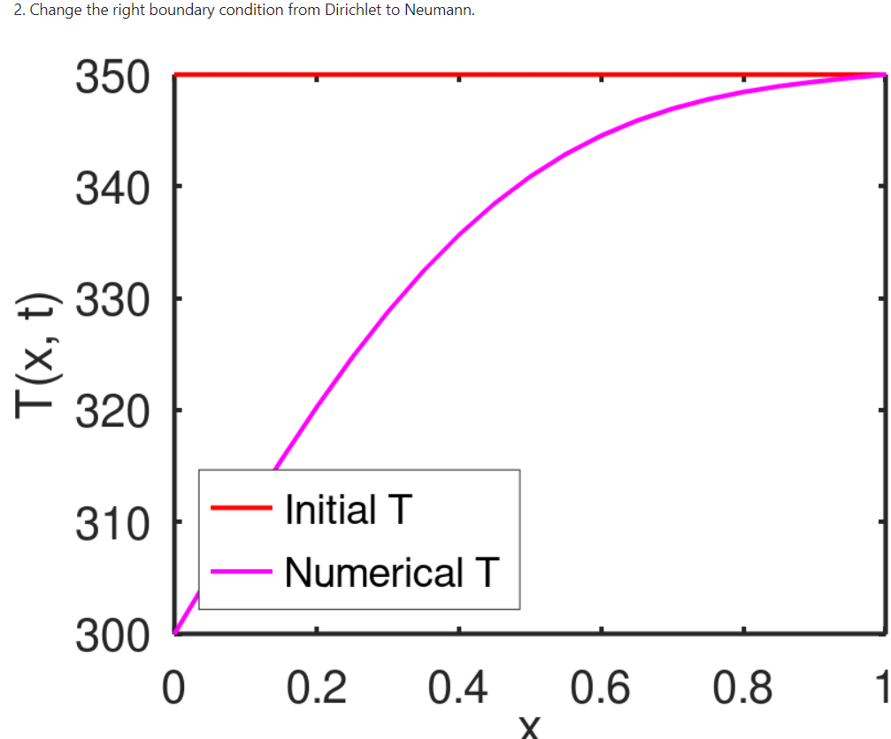
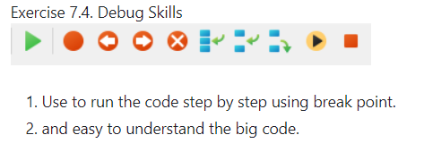
Quick Recap

Slide 4
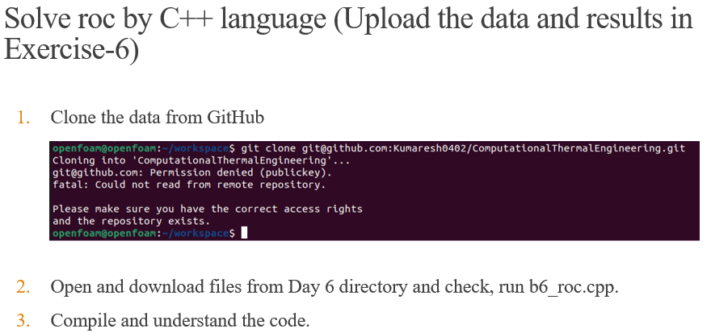
Quick Recap
Notes:
https://ezgif.com/maker
Dirichlet boundary conditions assume the solution to the variable.
In Neumann boundary conditions, a solution is assumed for the derivative of the variable.
https://en.wikipedia.org/wiki/Von_Neumann_stability_analysis

Slide 5
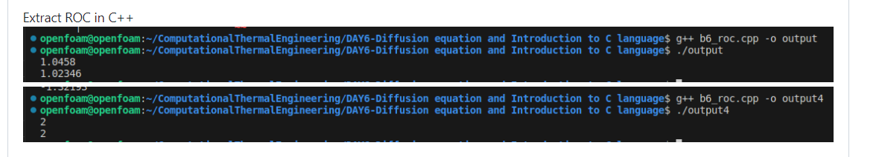
Quick Recap
Notes:
https://ezgif.com/maker
Dirichlet boundary conditions assume the solution to the variable.
In Neumann boundary conditions, a solution is assumed for the derivative of the variable.
https://en.wikipedia.org/wiki/Von_Neumann_stability_analysis

Slide 6
Contents
Introduction to OpenFOAM
OpenFOAM: Numerical Solution to Diffusion Equation

Slide 7
OpenFOAM - Introduction
OpenFOAM® stands for Open Source Field Operation and Manipulation.
OpenFOAM® is first and foremost a C++ library used to solve partial differential equations (PDEs), and ordinary differential equations (ODEs).
It comes with several ready-to-use or out-of-the-box solvers, pre-processing utilities and post-processing utilities.
It is licensed under the GNU General Public License (GPL).That means it is freely available and distributed with the source code.
OpenFOAM (Version v2306) is implemented in Ubuntu (version 22.04)
ParaView (version 5.1.0) for post-processing.

Slide 8
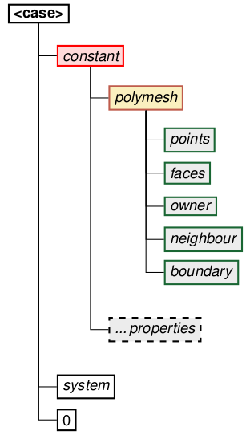
OpenFOAM – Directory Structure
constant: This directory contains the information which remains constant throughout the simulation. It contains the following:
1.1 polymesh: Contains all the mesh information including:
points → nodal positions
faces → face connectivity neighbor boundary
owner → owner cell labels
neighbor → neighbor cell labels
boundary → boundary information
1.2 properties: Files which specify physical properties for a particular application. Eg: gravity, viscosity, thermal and transport properties etc.

Slide 9
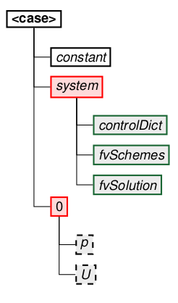
OpenFOAM – Directory Structure
2. system: This directory contains all the parameters associated with the solution procedure. It contains at least the following files:
2.1 blockmeshDict:
The principle behind blockMesh is to decompose the domain geometry into a set of 1 or more three dimensional, hexahedral blocks. This section describes the mesh generation utility, blockMesh, supplied with OpenFOAM. The blockMesh utility creates parametric meshes with grading and curved edges. BlockMesh reads this dictionary, generates the mesh and writes out the mesh data to points and faces, cells and boundary files in the same directory.
2.2 controlDict: Specifies the run control parameters such as start/ end time, time step, write interval etc.
2.3 fvSchemes: Contains the finite volume discretization schemes used for the solution procedure such as spatial and temporal discretizations.
2.4 fvSolution: Contains equation solvers, algorithm controls and tolerances for the implicit solvers.
3. 0: The ’0’ directory corresponds to zero time. It contains the initial and boundary conditions for variables (i.e. pressure p, velocity U) in individual files

Slide 10

CFD Developers
Developers are the ones who write code on the back end.
To make it simple for CFD amateur students, let's say ANSYS Fluent and Star CCM are written by developers (by writing code at the back end), so we could easily use them as black box (GUI) tools.
Developers are the key to the development of technology.

Slide 11

Is it good to be a black box user or a developer ?
A developer can handle anything from scratch. That brings confidence by capable of solving any puzzles.
Understanding the logic is an art, so being a developer helps know exactly what and how to do.
It's good to be a black box user in the beginning to understand the basic ideas/physics, but in order to route your future, trust me, developers can handle it better.

Slide 12

How to grow as a developer ?
Work with passion
Face the hurdles and don’t get tired of it
Never lose the joy of programming
Test your skills in open-source projects
Read code and do code reviews
Learn from your colleagues and mentors
Share your knowledge

Slide 13
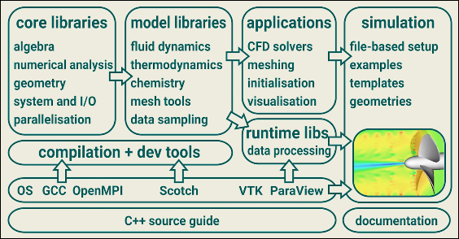
How to grow as a developer ? → OpenFOAM
OpenFOAM is a software framework (or toolbox) that you can use to develop Finite Volume Method based solvers for general continuum mechanics problems mostly for fluid flow and heat transfer.
It is a huge library of about 1.5 million lines of C++ code located in hundreds of files.
You can use this toolbox to develop Computational Fluid Dynamics (CFD) solvers.

Slide 14
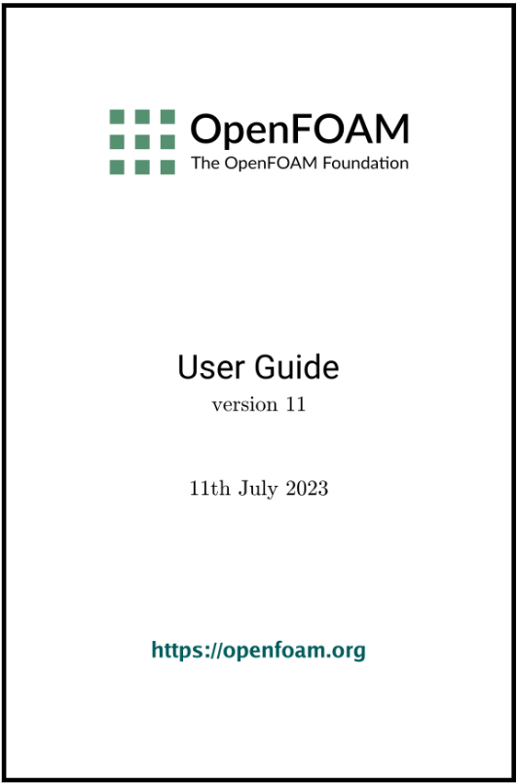
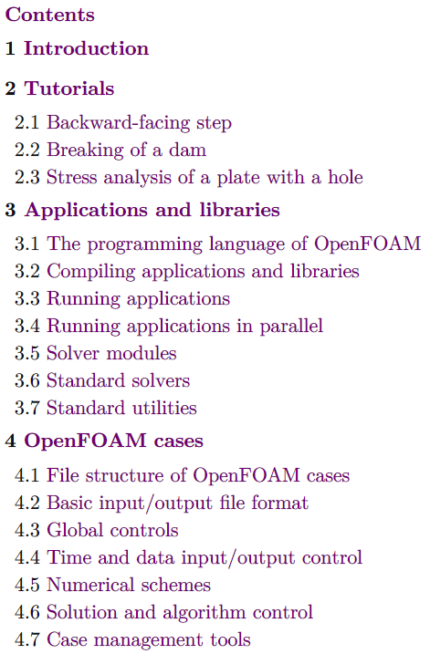
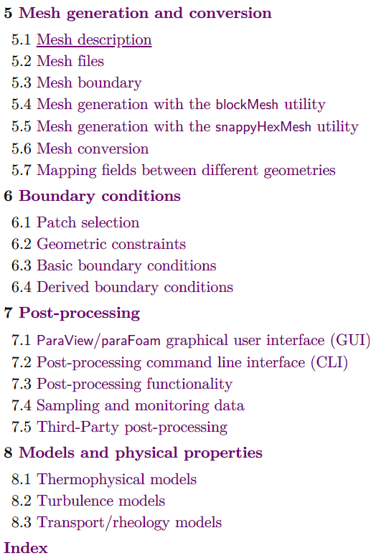
The OpenFOAM User Guide provides an introduction to OpenFOAM, through some basic tutorials, and some details about the general operation of OpenFOAM. OpenFOAM is a collection of approximately 150 applications built upon a collection of approximately 150 software libraries (modules).
OpenFOAM User GUIDE

Slide 15
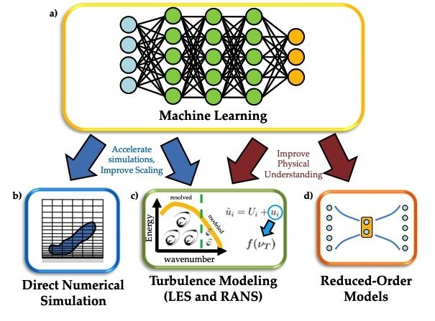
Machine Learning in CFD
To understand certain critical parameters in any physical phenomenon, data optimisation can be implemented by machine learning algorithms.
By definition, machine learning is a branch of artificial intelligence (AI) and computer science that focuses on the use of data and algorithms to imitate the way that humans learn, gradually improving its accuracy.
The data optimisation saves simulation time to interpret the phenomenon by improving accuracy. This is in the current developing stage of this technology world.
This improvisation will assist steel industry technologies in prospering and creating a better future.

Slide 17
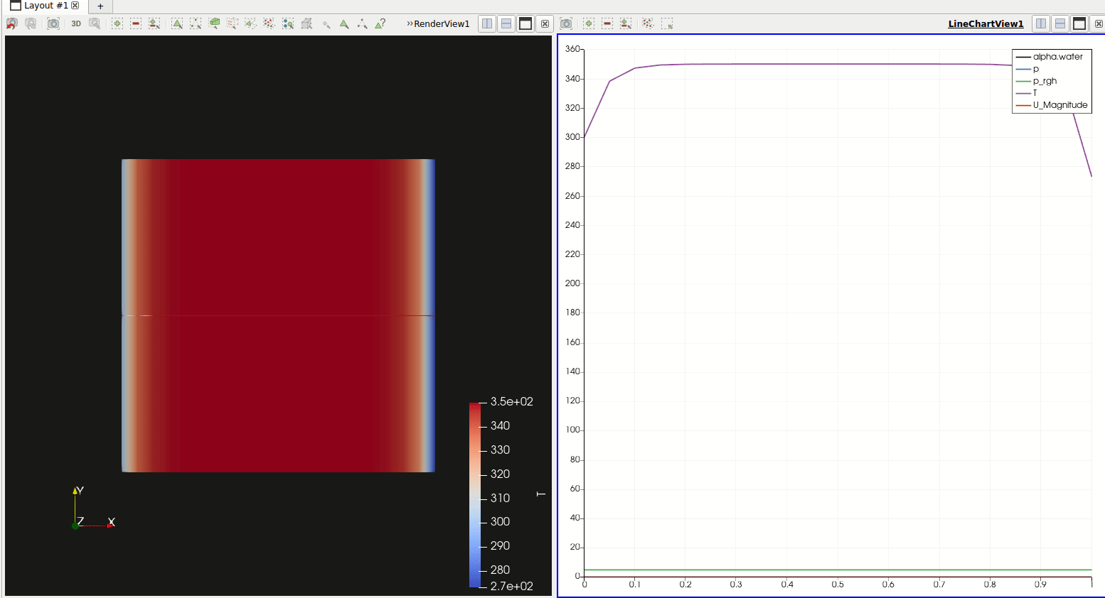
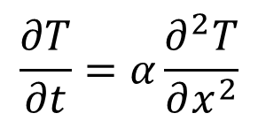
OpenFOAM: Numerical Solution to Diffusion Equation
Paraview – Post Processing tool in OpenFOAM
$$\frac{∂T}{∂t}=α\frac{∂^{2}T}{∂x^{2}}$$

Slide 18
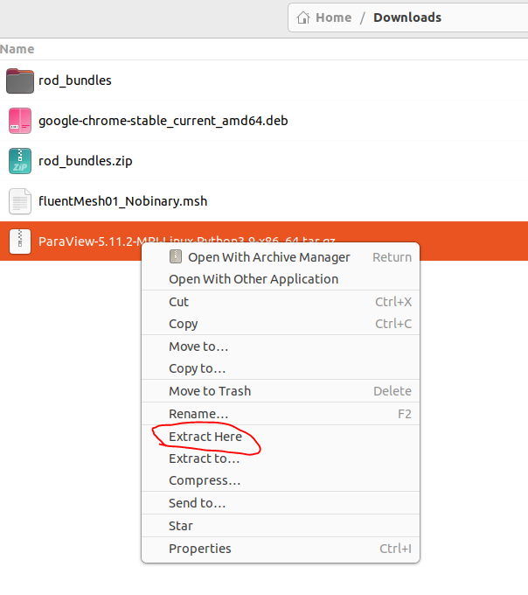
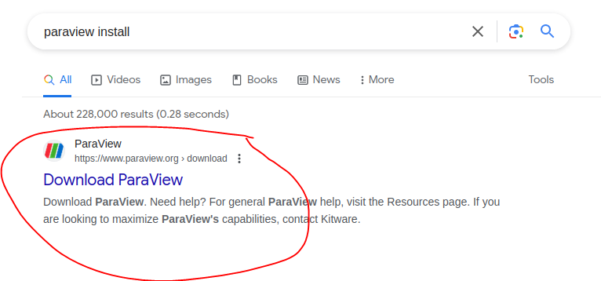
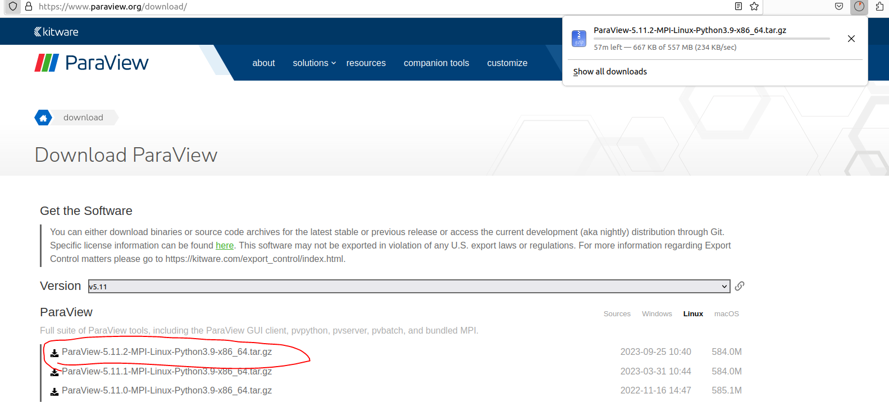
Install “Paraview”
3
1
2

Slide 19
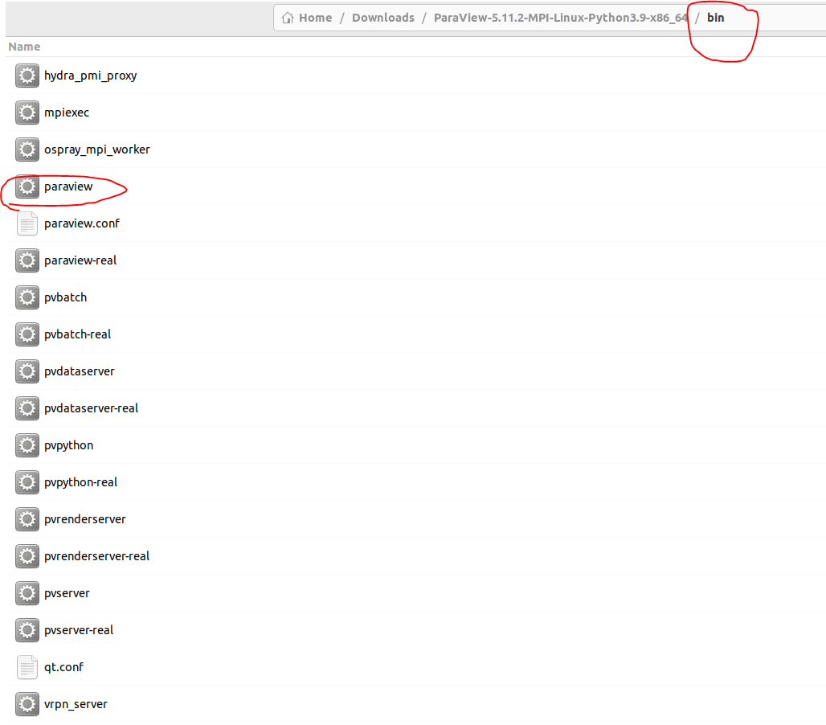
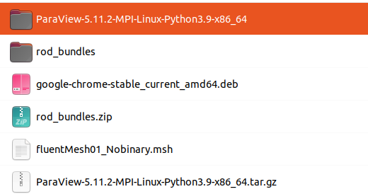
Install “Paraview”
5
Double click “paraview”
4

Slide 20
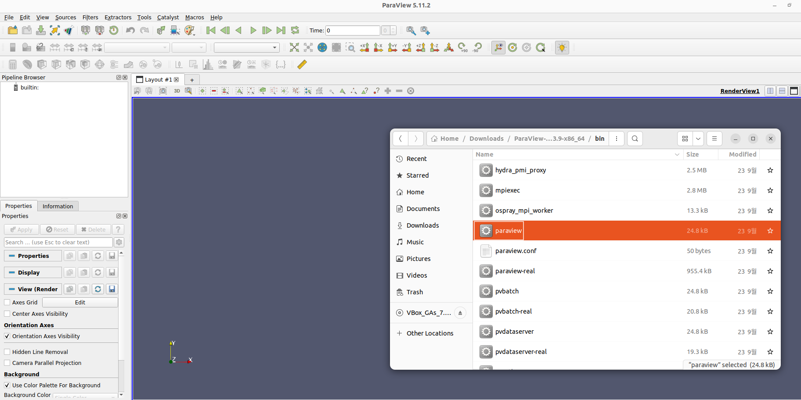
Open “Paraview”
Used for post-processing your results

Slide 21
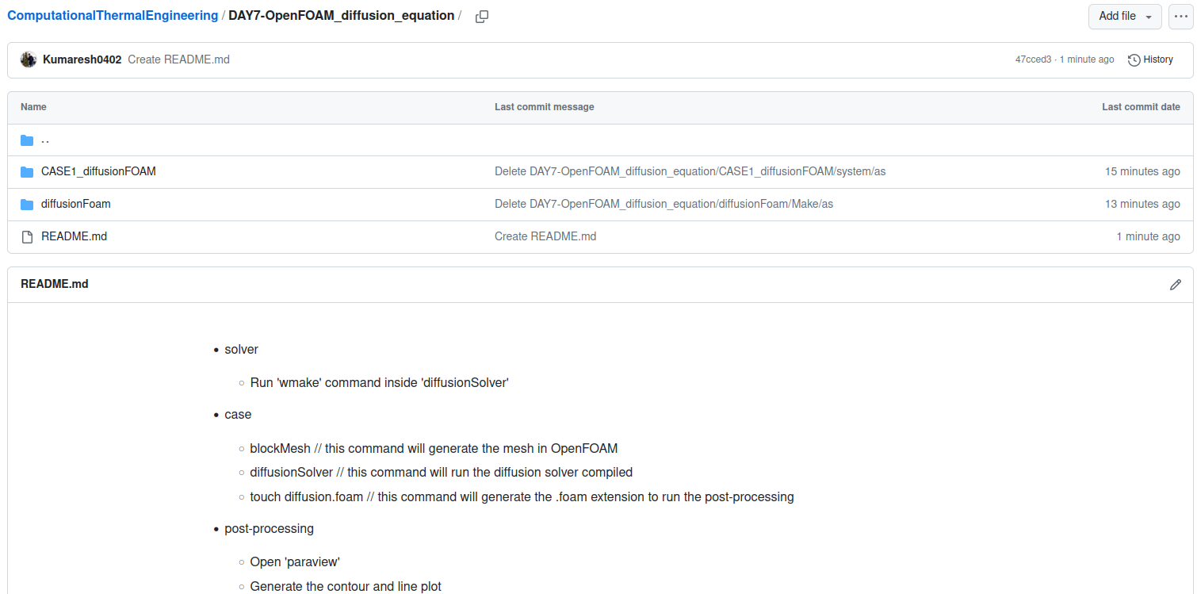
Extract files from GitHub

Slide 22
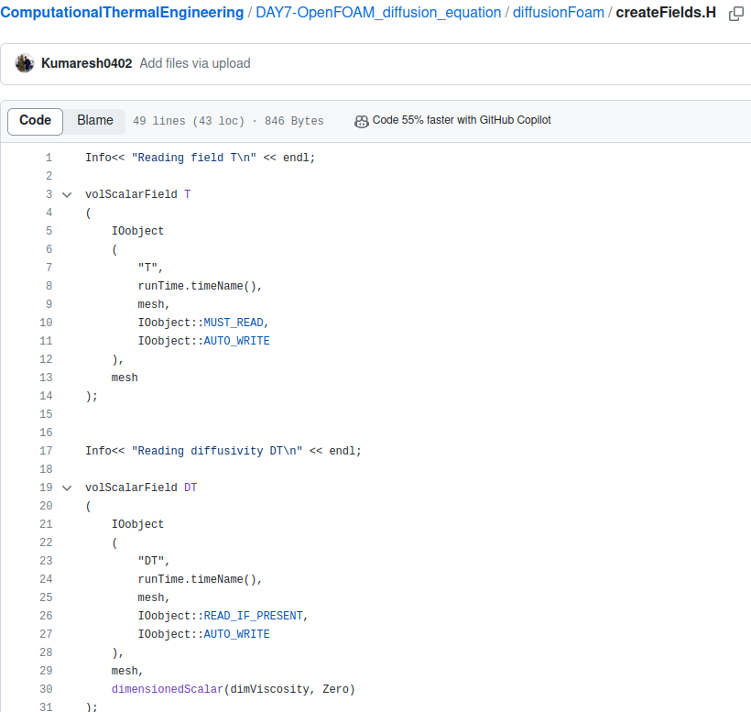
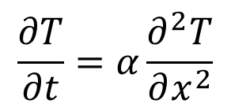
solver file ➔ diffusionFoam/createFields.H
$$\frac{∂T}{∂t}=α\frac{∂^{2}T}{∂x^{2}}$$
Temperature “T” field is created
Diffusivity as a field created

Slide 23
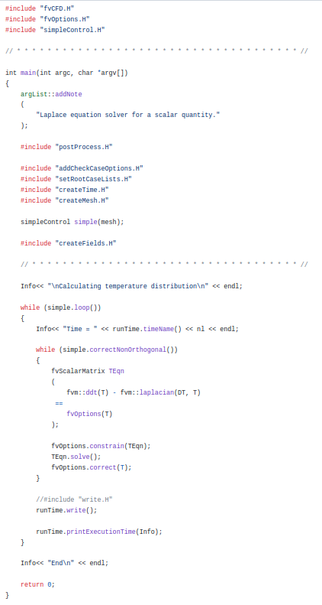
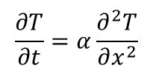
solver file ➔ diffusionFoam/diffusionFoam.C
Necessary “header” files
Matrix is created to solve “FVM”
$$\frac{∂T}{∂t}=α\frac{∂^{2}T}{∂x^{2}}$$

Slide 24
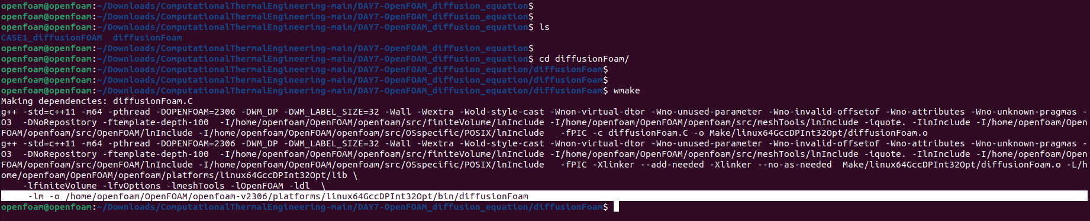
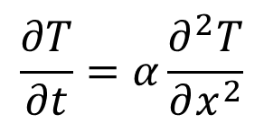
Compile diffusionFoam “solver”
$$\frac{∂T}{∂t}=α\frac{∂^{2}T}{∂x^{2}}$$
Compiled “diffusionFoam“ solver

Slide 25
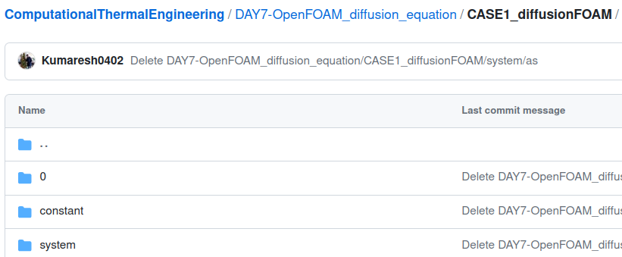
case file
$$\frac{∂T}{∂t}=α\frac{∂^{2}T}{∂x^{2}}$$
Initial conditions
Properties
Mesh, schemes, solvers, algorithm controls and tolerances for the implicit solvers.

Slide 26
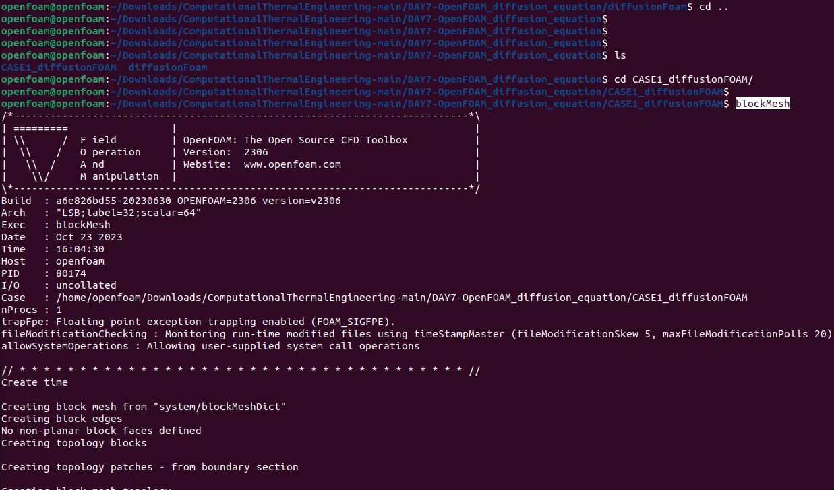
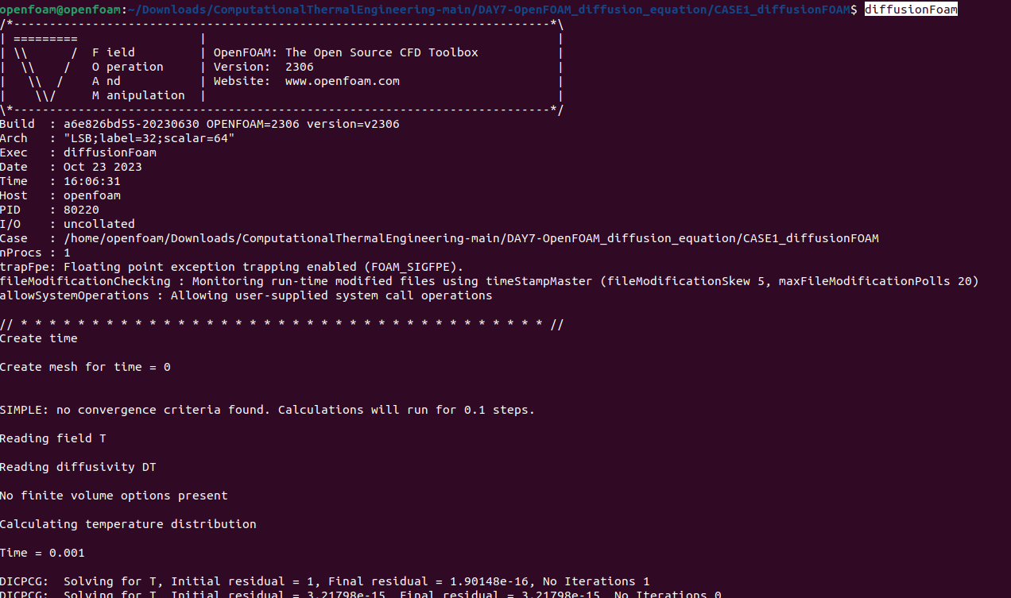
Compile the “case” file named – CASE1_diffusionFOAM
2
1

Slide 27
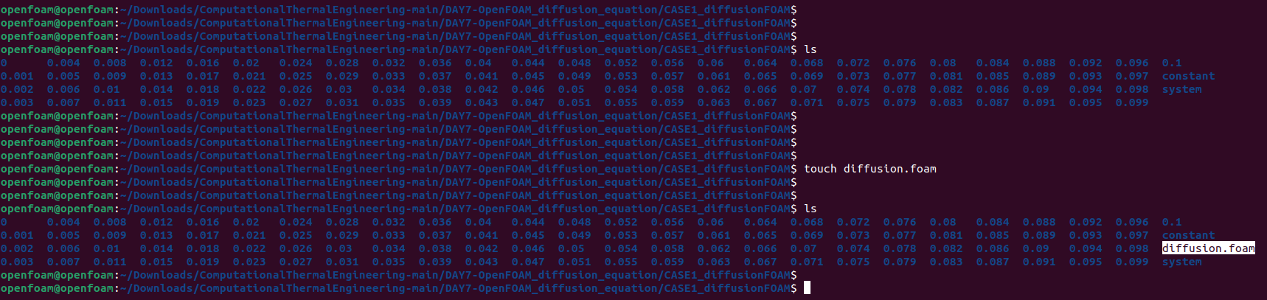
Compile the “case” file named – CASE1_diffusionFOAM
3

Slide 28
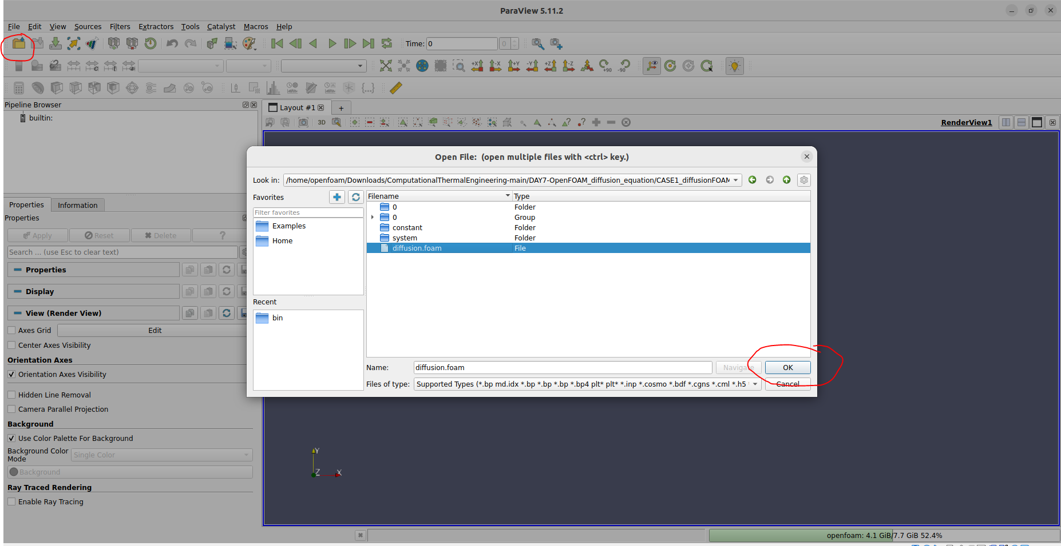
Open the “case” in paraview
4

Slide 29
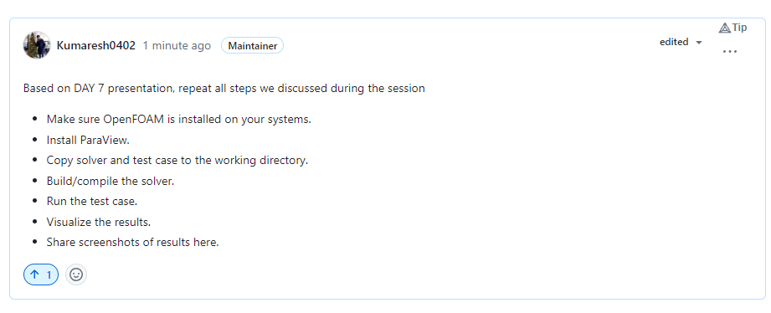
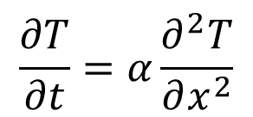
Project – 1 (Diffusion Equation using OpenFOAM)
$$\frac{∂T}{∂t}=α\frac{∂^{2}T}{∂x^{2}}$$

Slide 30
Email OpenFOAM notes
Basic Module
Advanced Module
Programming Module

Slide 31
Next session: Research Project Presentation
(31st October, 2023)
- Every individual should take a presentation for 15 minutes. This topic carries high marks. Please prepare and present it carefully.
- Query session: 5 minutes.
- Every individual should ask a single question during the presentation.

